Slide 1
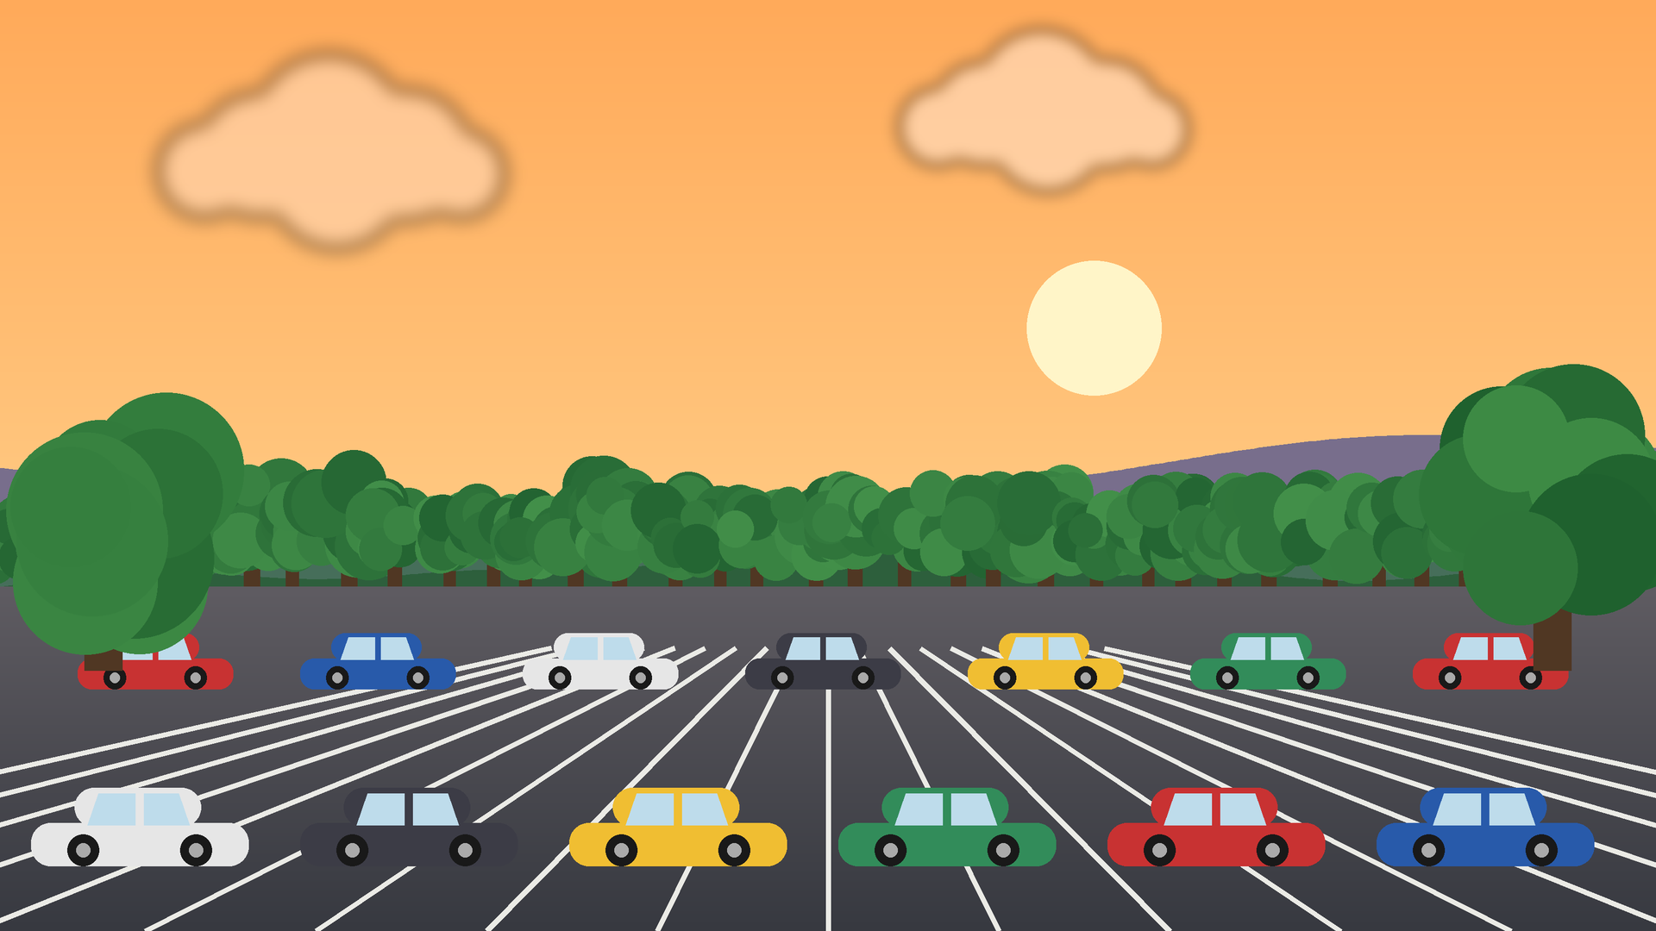
PARKING RESERVATION SYSTEM
Smart Parking · Easy Booking · Less Waiting

Slide 2
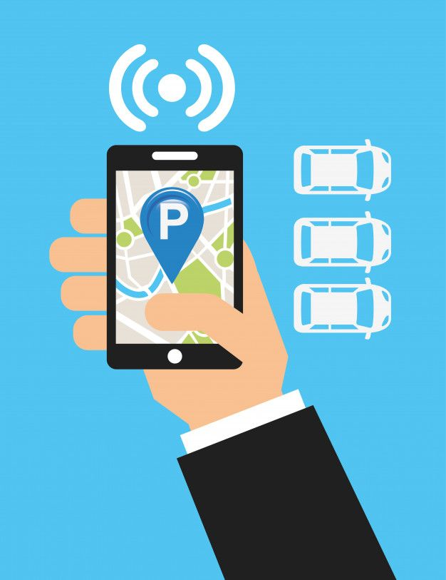
Team Members
V. TARUNI
24KB1A05MZ
V. SRIJA
24KB1A05MP
G. NIKHITHA
24KB1A05G6
T. TEJASRI
24KB1A05LF
CH. RUCHITHA
24KB1A0594

Slide 3
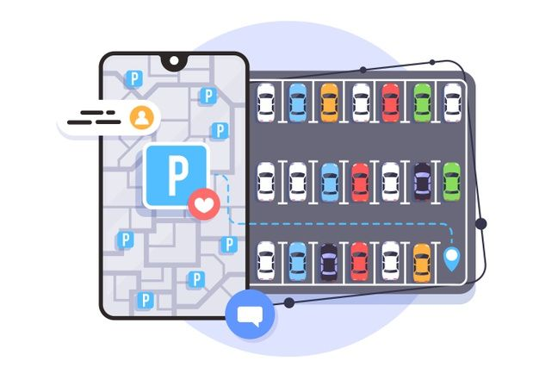
Introduction
Parking spaces are limited, vehicles keep growing
Drivers waste time and fuel searching for a slot
Parking Reservation System lets users book a slot in advance
Simple web application for users and admin

Slide 4
Problem Statement
No way to know slot availability before arriving
Long queues and traffic near parking areas
Manual record keeping causes errors
No advance booking or online payment

Slide 5
Objectives
Book a parking slot online
Show real-time slot availability
1
2
Reduce time and fuel wasted
Automate records and billing
3
4

Slide 6
Technologies Used
Front End
React.js
Back End
Node.js
Database
MySQL
Tools
VS Code, Node.js, XAMPP, Git, GitHub

Slide 7
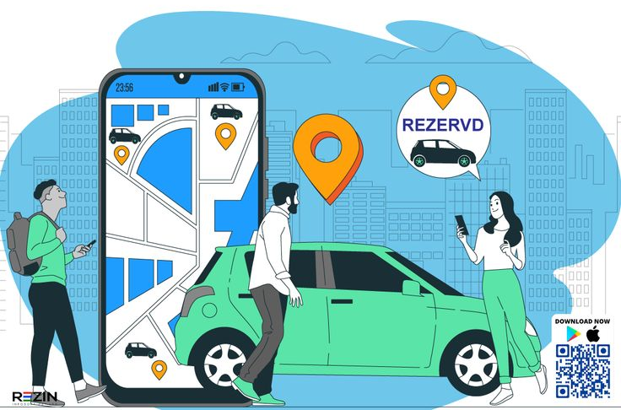
Modules
User Module: Register, login, search and book slots
Admin Module: Add slots, manage users and bookings
Payment Module: Calculate fee, confirm payment
Reports Module: Booking history and usage reports

Slide 8
How It Works
1
Register / Login
2
Search Slot
3
Select Date & Time
4
Pay & Confirm
5
Park & Exit
Users reserve in advance and arrive straight to their slot

Slide 9
Existing vs Proposed System
Existing System
Proposed System
Manual entry, paper records
No advance booking
Slot search takes time
Online slot reservation
Live availability status
Automatic fee and records

Slide 10
Advantages
Saves time and fuel
Reduces traffic and queues
Better use of parking space
Fast, paperless and accurate records

Slide 11
Future Scope
Mobile app with live navigation
QR code entry and exit
Sensor / camera based slot detection
Online wallet and UPI payments

Slide 12
Conclusion
The Parking Reservation System makes parking simple, fast and organised. It saves time, reduces congestion and helps build smarter, greener cities.

Slide 13

THANK YOU
Any Questions?

